Slide 1
ECE 476
Power System Analysis
Lecture 10: Per Unit, Three-Phase Transformers, Load and Generators
Prof. Tom Overbye
Dept. of Electrical and Computer Engineering
University of Illinois at Urbana-Champaign
overbye@illinois.edu

Slide 2
Announcements
Please read Chapter 2.4, Chapter 6 up to 6.6
HW 4 is due now; HW 5 is 5.31, 5.43, 3.4, 3.10, 3.14, 3.19, 3.23, 3.60, 6.30 should be done before exam 1
Exam 1 is Thursday Oct 6 in class
  Closed book, closed notes, but you may bring one 8.5 by 11 inch note sheet and standard calculators
  Last name A-M here, N to Z in ECEB 1013
Power Area Scholarships, Awards (Oct 1 deadlines, except Nov 1 for Grainger)
  http://energy.ece.illinois.edu/
  Turn both into Prof Sauer (4046 or 4060)

Slide 3
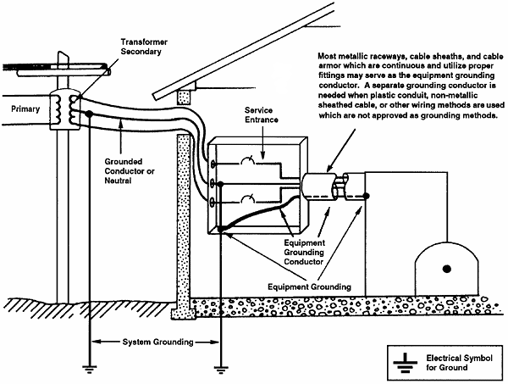
Service Entrance Grounding
We’ll
talk more
about
grounding
later in
the semester
when we
cover faults
Image: www.osha.gov/dte/library/electrical/electrical_10.gif

Slide 4
Per Unit Calculations
A key problem in analyzing power systems is the large number of transformers.
  It would be very difficult to continually have to refer impedances to the different sides of the transformers
This problem is avoided by a normalization of all variables.
This normalization is known as per unit analysis.

Slide 5
Per Unit Conversion Procedure, 1φ
Pick a 1φ VA base for the entire system, S_{B}
Pick a voltage base for each different voltage level, V_{B}. Voltage bases are related by transformer turns ratios. Voltages are line to neutral.
Calculate the impedance base, Z_{B}= (V_{B})²/S_{B}
Calculate the current base, I_{B} = V_{B}/Z_{B}
Convert actual values to per unit
Note, per unit conversion on affects magnitudes, not
the angles. Also, per unit quantities no longer have
units (i.e., a voltage is 1.0 p.u., not 1 p.u. volts)

Slide 6
Per Unit Solution Procedure
Convert to per unit (p.u.) (many problems are already in per unit)
Solve
Convert back to actual as necessary

Slide 7
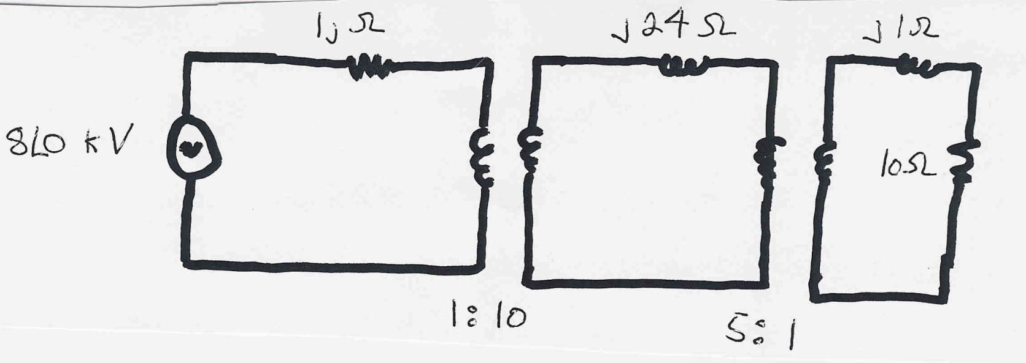
Per Unit Example
Solve for the current, load voltage and load power
in the circuit shown below using per unit analysis
with an S_{B} of 100 MVA, and voltage bases of
8 kV, 80 kV and 16 kV.
Original Circuit

Slide 8

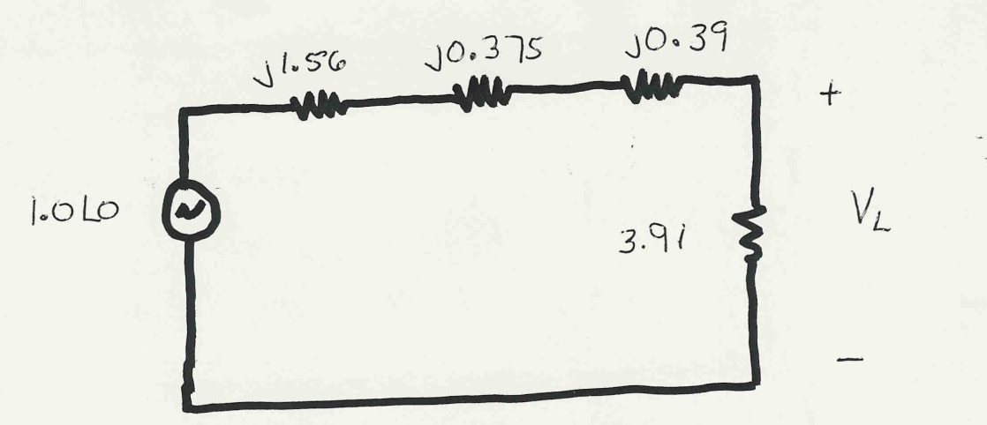
Per Unit Example, cont’d
Same circuit, with
values expressed
in per unit.

Slide 9
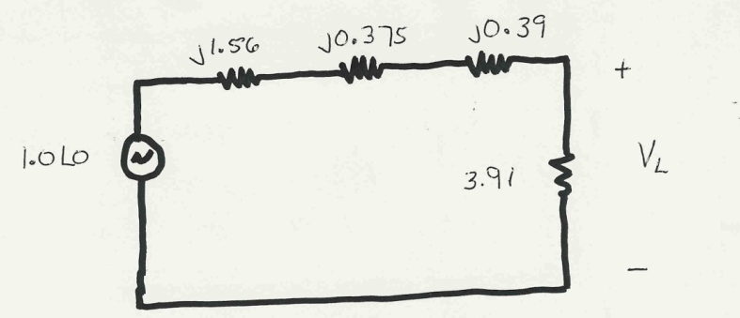
Per Unit Example, cont’d

Slide 10
Per Unit Example, cont’d
To convert back to actual values just multiply the
per unit values by their per unit base

Slide 11
Three Phase Per Unit
Procedure is very similar to 1φ except we use a 3φ
VA base, and use line to line voltage bases
Pick a 3φ VA base for the entire system,
Pick a voltage base for each different voltage level, V_{B}. Voltages are line to line.
Calculate the impedance base
Exactly the same impedance bases as with single phase!

Slide 12
Three Phase Per Unit, cont'd
Calculate the current base, I_{B}
Convert actual values to per unit
Exactly the same current bases as with single phase!

Slide 13

Three Phase Per Unit Example
Solve for the current, load voltage and load power
in the previous circuit, assuming a 3φ power base of
300 MVA, and line to line voltage bases of 13.8 kV,
138 kV and 27.6 kV (square root of 3 larger than the 1φ example voltages). Also assume the generator is Y-connected so its line to line voltage is 13.8 kV.
Convert to per unit
as before. Note the
system is exactly the
same!

Slide 14
3φ Per Unit Example, cont'd
Again, analysis is exactly the same!

Slide 15
3φ Per Unit Example, cont'd
Differences appear when we convert back to actual values

Slide 16
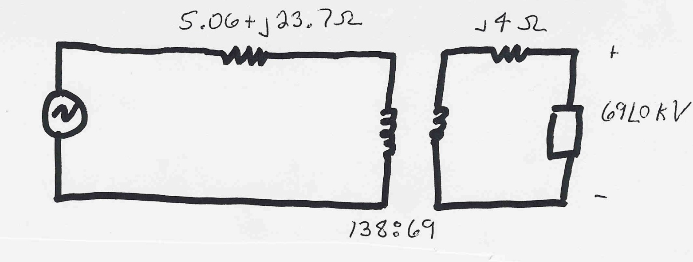
3φ Per Unit Example 2
Assume a 3φ load of 100+j50 MVA with V_{LL} of 69 kV is connected to a source through the below network:
What is the supply current and complex power?
Answer: I=467 amps, S = 103.3 + j76.0 MVA

Slide 17
Per Unit Change of MVA Base
Parameters for equipment are often given using power rating of equipment as the MVA base
To analyze a system all per unit data must be on a common power base

Slide 18
Per Unit Change of Base Example
A 54 MVA transformer has a leakage reactance of 3.69%. What is the reactance on a 100 MVA base?

Slide 19
Transformer Reactance
Transformer reactance is often specified as a percentage, say 10%. This is a per unit value (divide by 100) on the power base of the transformer.
Example: A 350 MVA, 230/20 kV transformer has leakage reactance of 10%. What is p.u. value on 100 MVA base? What is value in ohms (230 kV)?

Slide 20
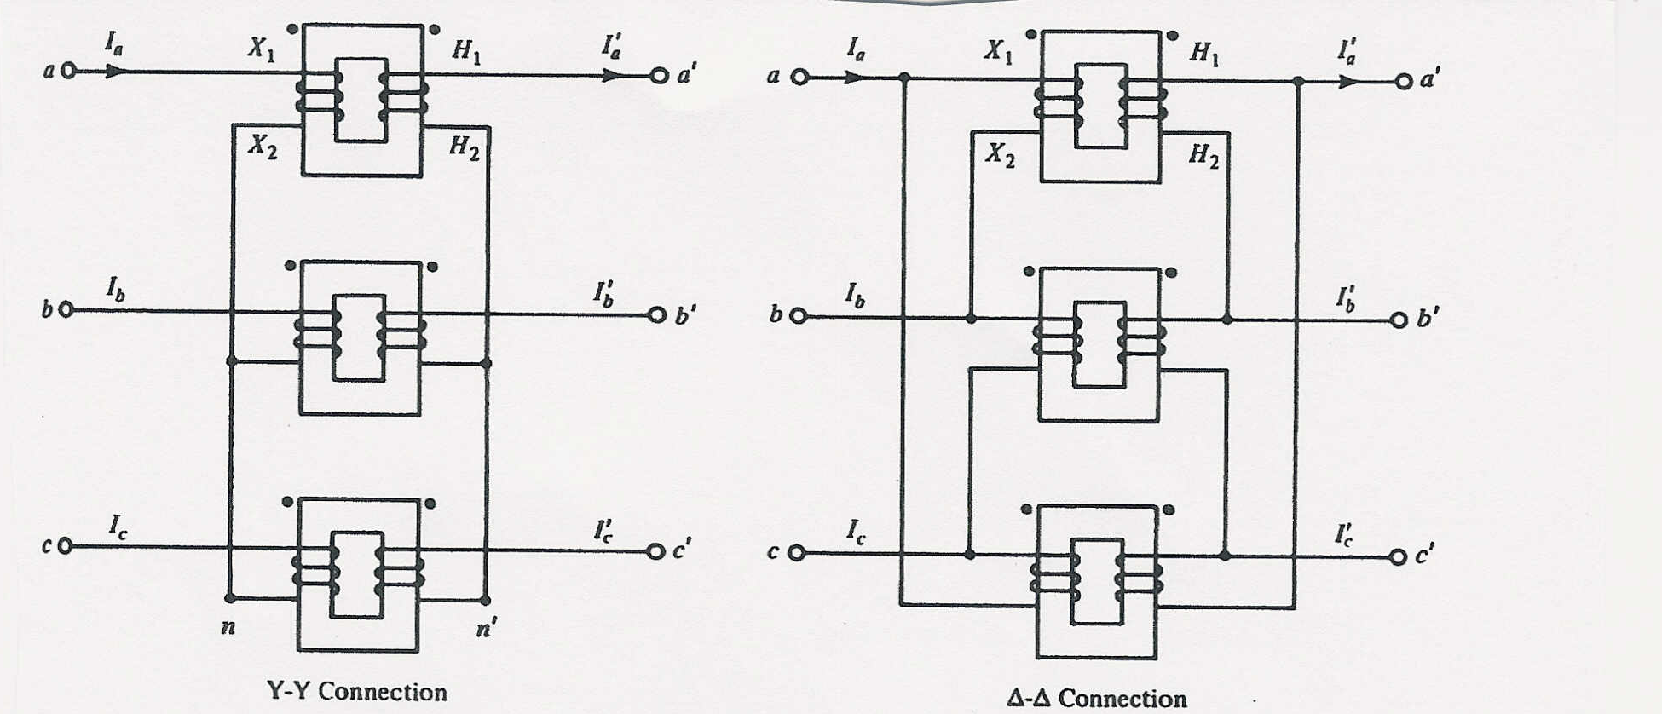
Three Phase Transformers
There are 4 different ways to connect 3φ transformers
Y-Y
Δ-Δ
Usually 3φ transformers are constructed so all windings
share a common core

Slide 21

3φ Transformer Interconnections
Δ-Y
Y-Δ

Slide 22
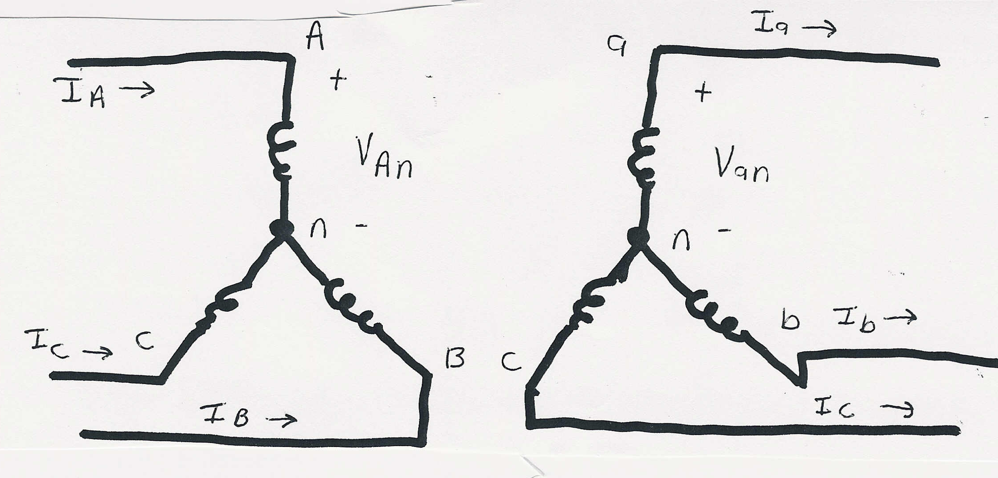
Y-Y Connection

Slide 23
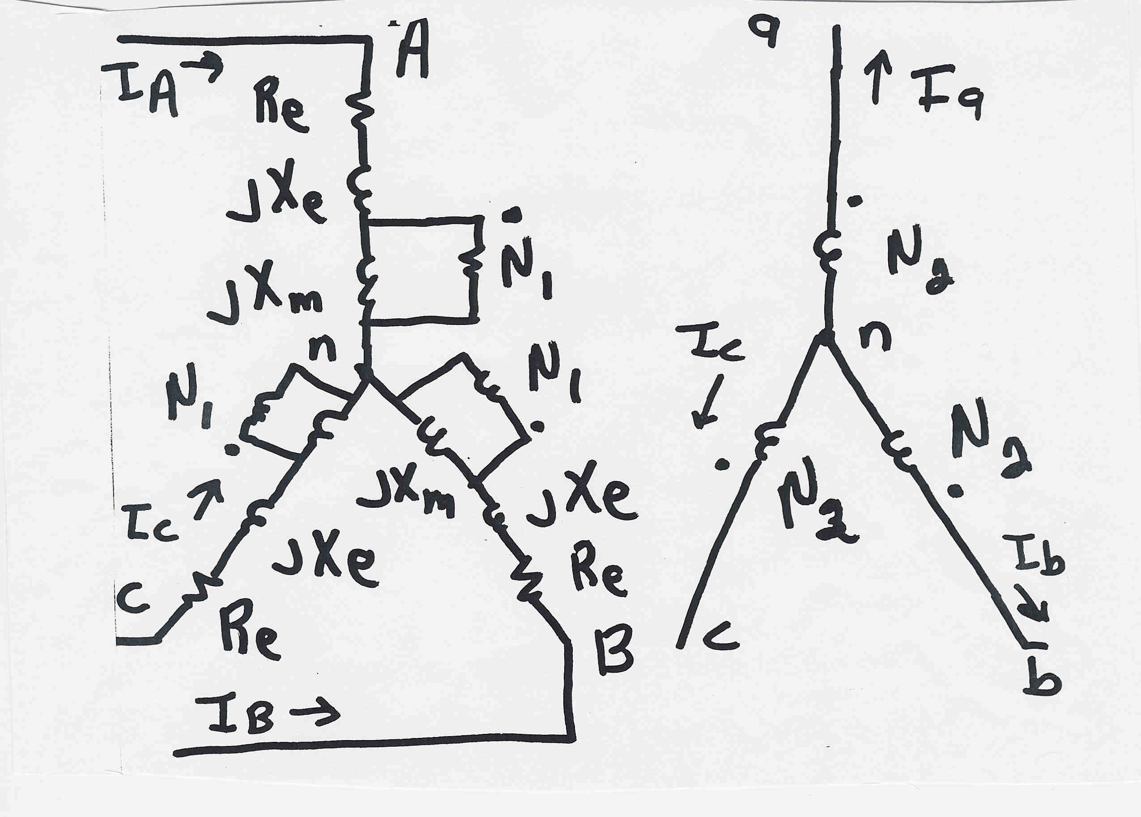
Y-Y Connection: 3φ Detailed Model

Slide 24
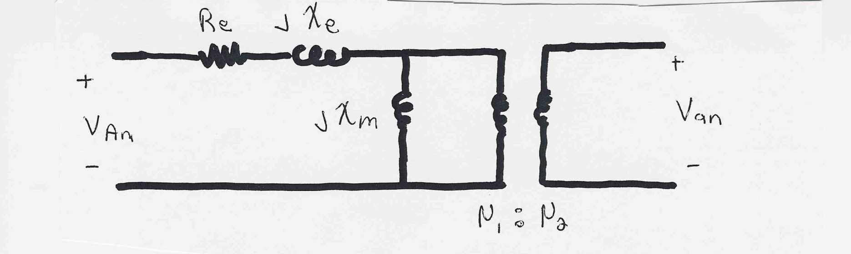
Y-Y Connection: Per Phase Model
Per phase analysis of Y-Y connections is exactly the
same as analysis of a single phase transformer.
Y-Y connections are common in transmission systems.
Key advantages are the ability to ground each side
and there is no phase shift is introduced.

Slide 25
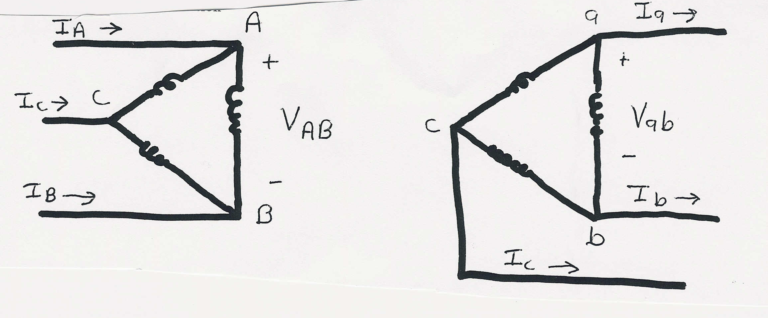
Δ-Δ Connection

Slide 26
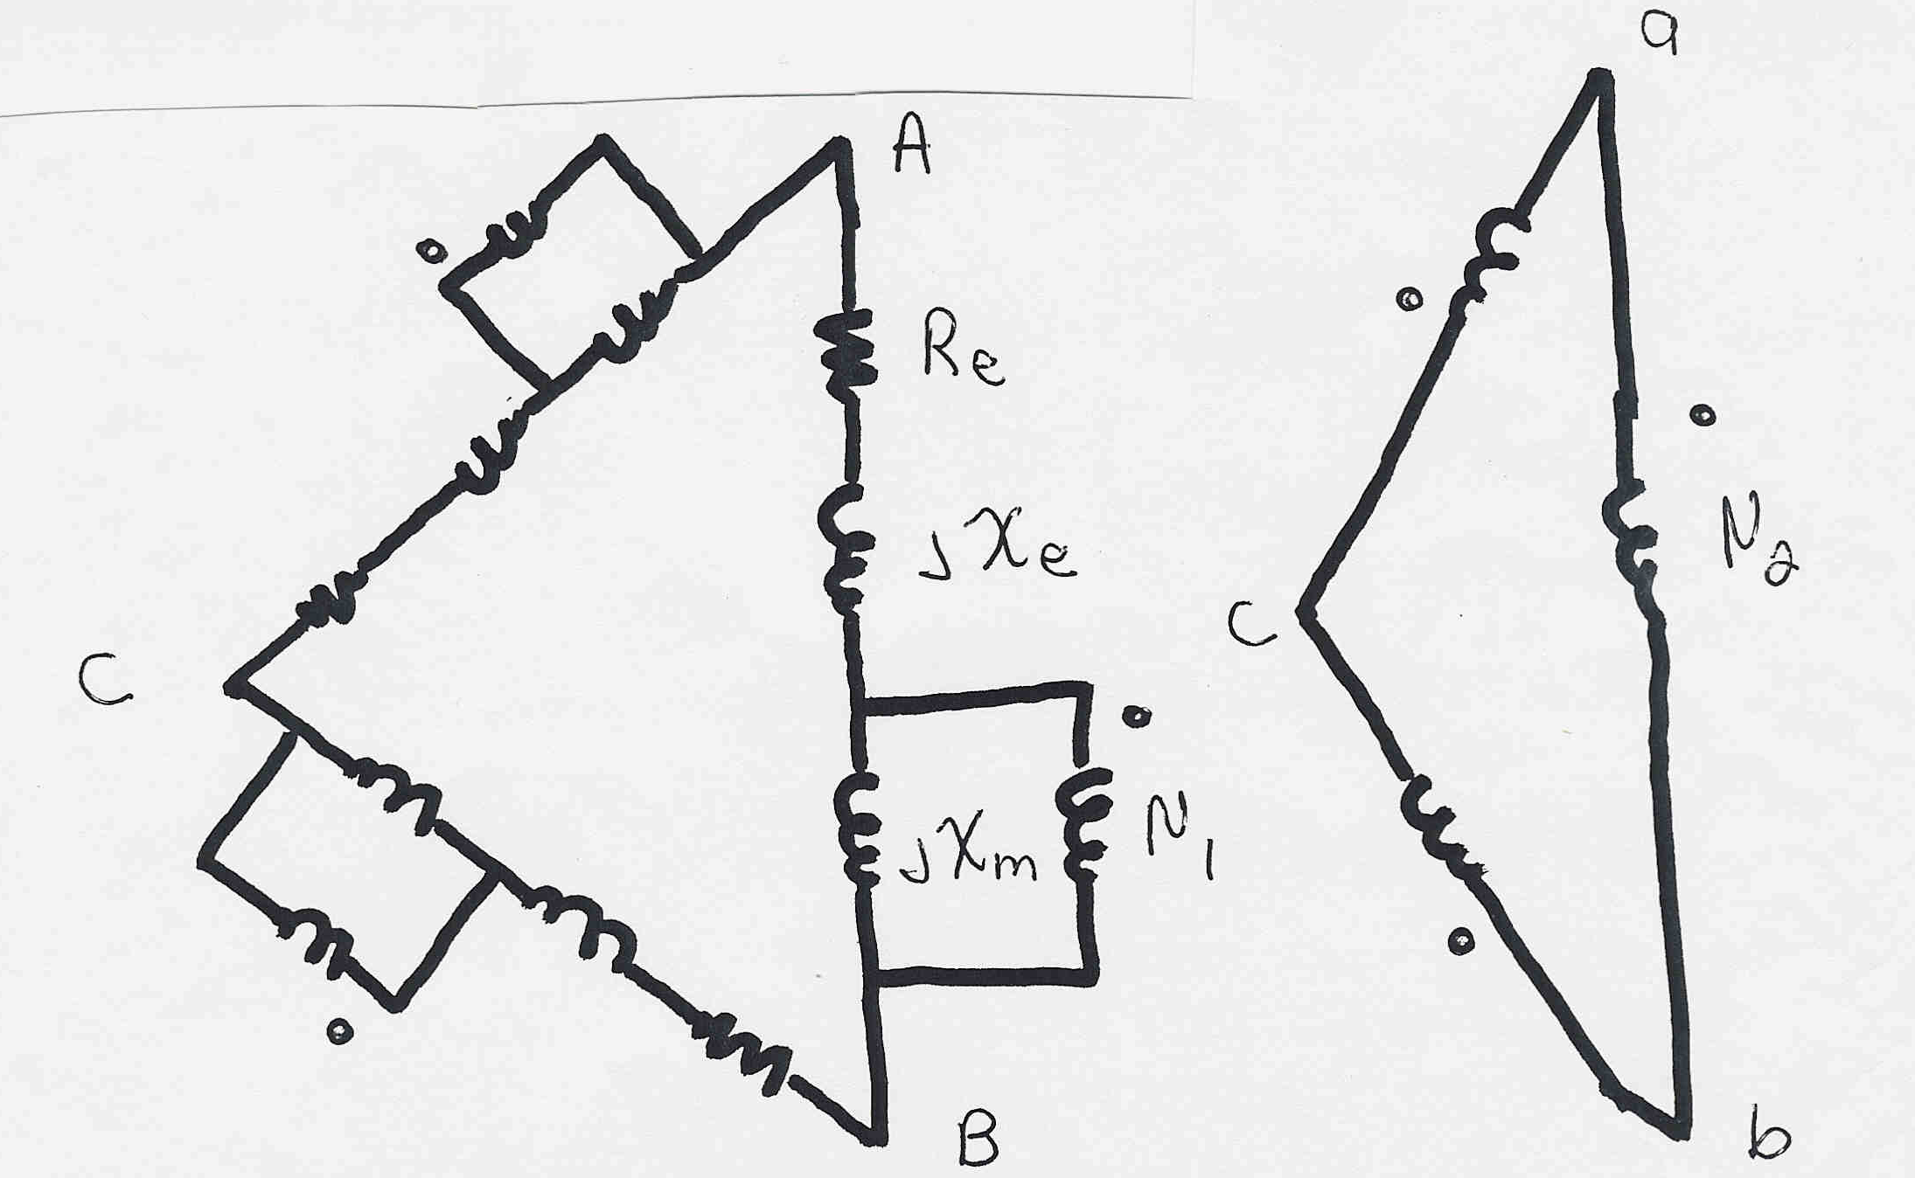
Δ-Δ Connection: 3φ Detailed Model
To use the per phase equivalent we need to use
the delta-wye load transformation

Slide 27
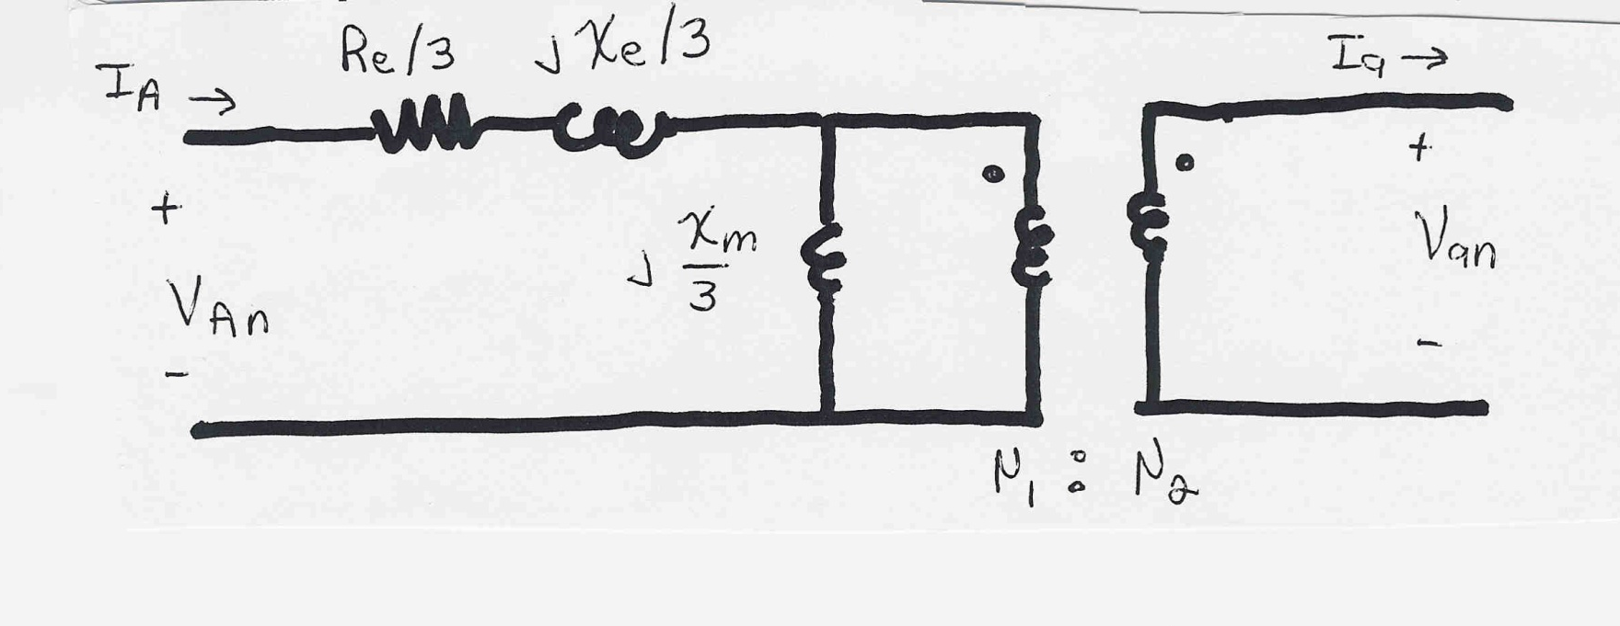
Δ-Δ Connection: Per Phase Model
Per phase analysis similar to Y-Y except impedances are decreased by a factor of 3.
Key disadvantage is Δ-Δ connections can not be grounded; not commonly used.

Slide 28
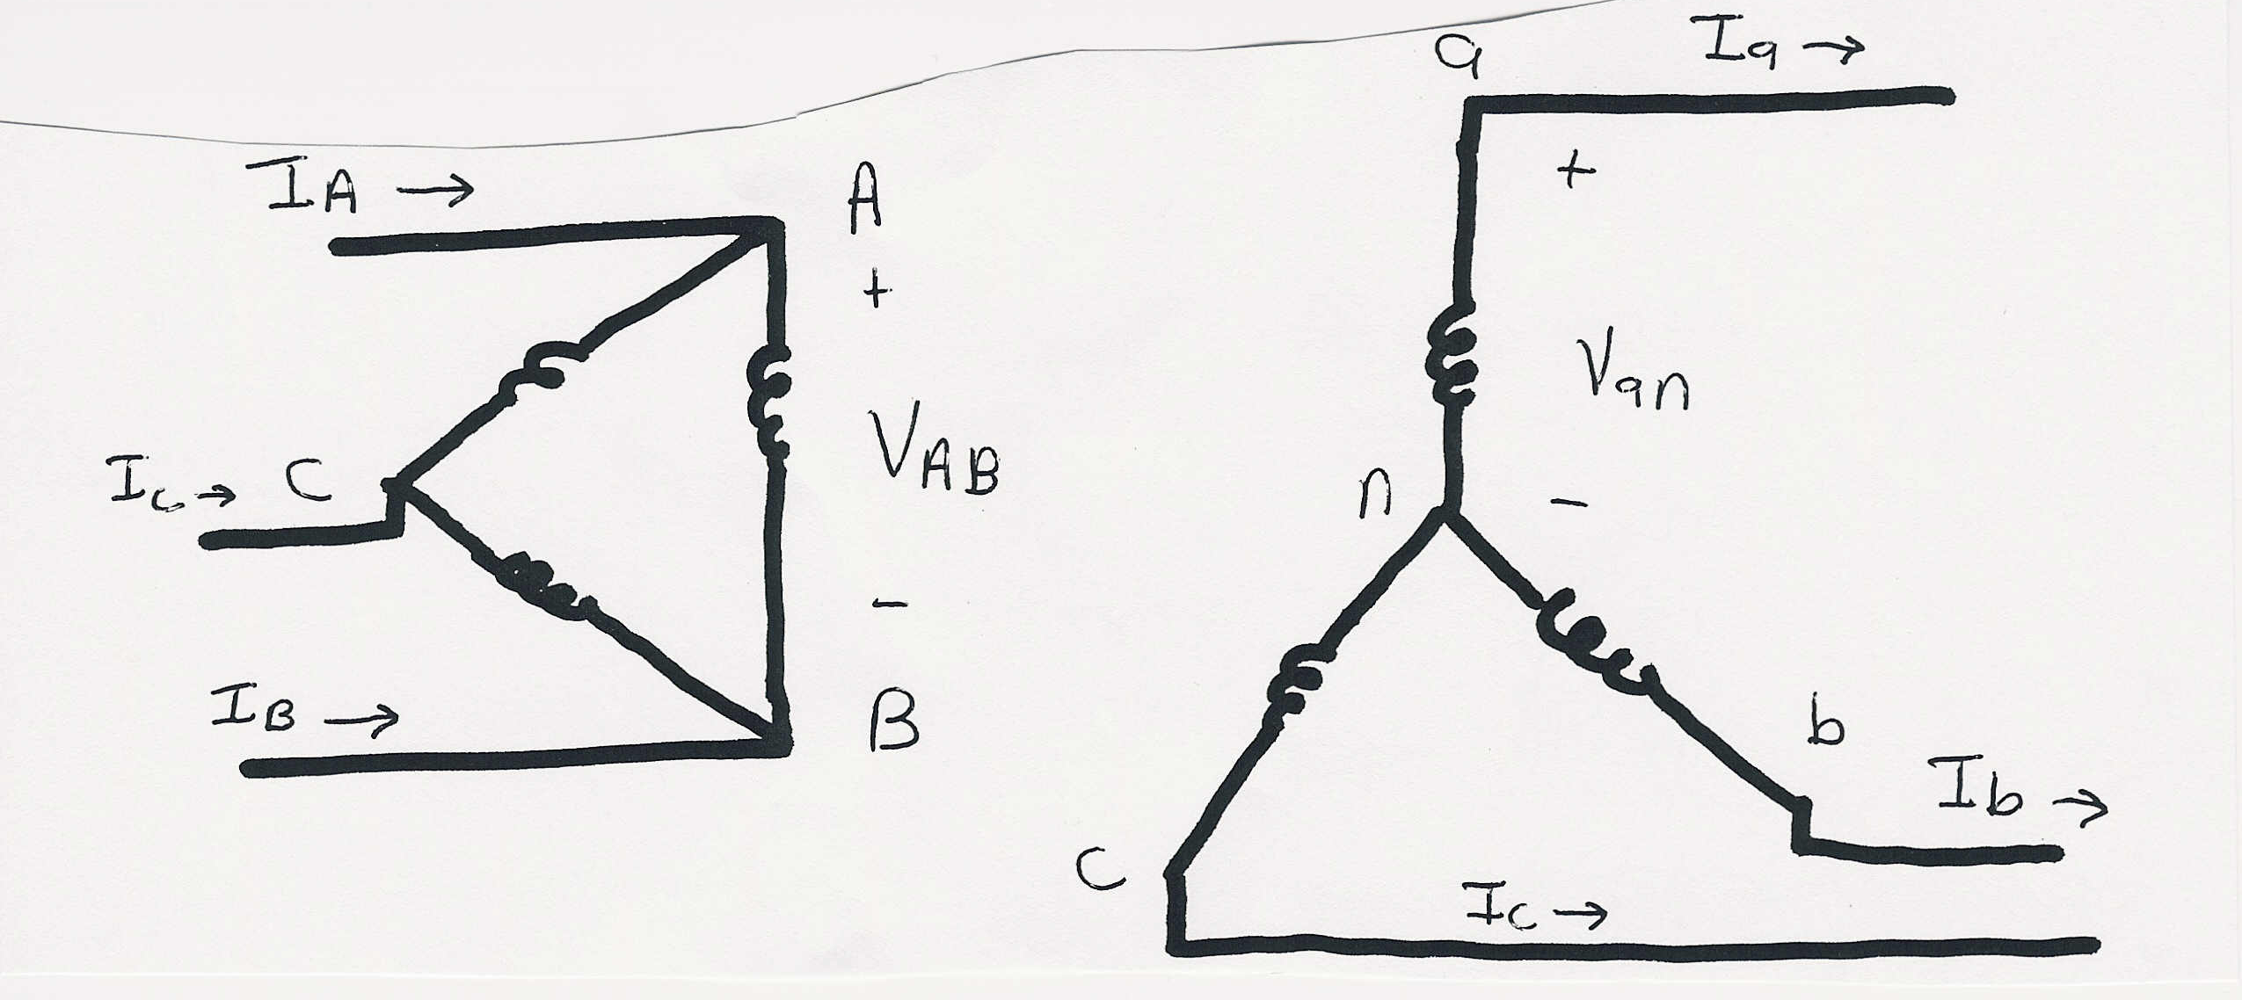
Δ-Y Connection

Slide 29
Δ-Y Connection V/I Relationships

Slide 30
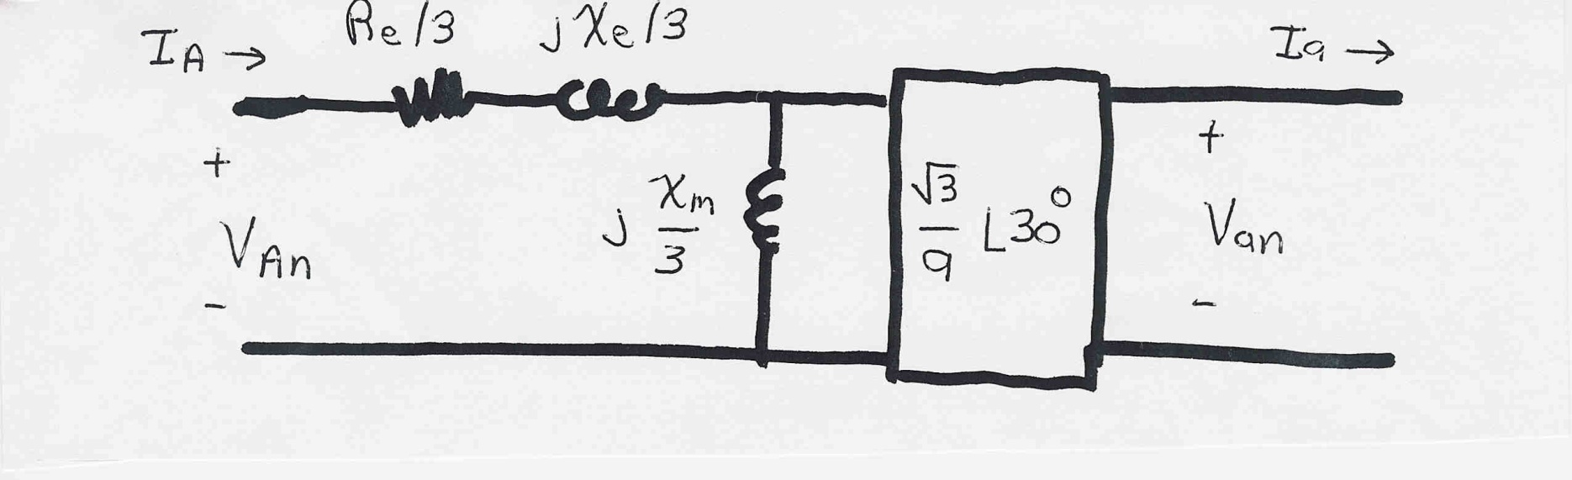
Δ-Y Connection: Per Phase Model
Note: Connection introduces a 30 degree phase shift!
Common for transmission/distribution step-down since
there is a neutral on the low voltage side.
Even if a = 1 there is a sqrt(3) step-up ratio

Slide 31
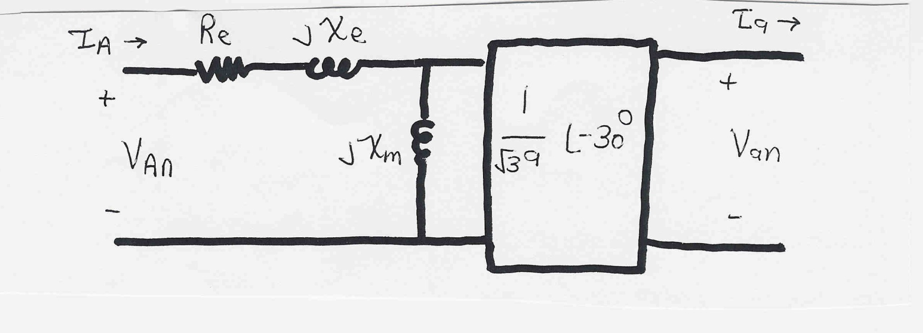
Y-Δ Connection: Per Phase Model
Exact opposite of the Δ-Y connection, now with a
phase shift of -30 degrees.

Slide 32
Load Tap Changing Transformers
LTC transformers have tap ratios that can be varied to regulate bus voltages
The typical range of variation is ±10% from the nominal values, usually in 33 discrete steps (0.0625% per step).
Because tap changing is a mechanical process, LTC transformers usually have a 30 second deadband to avoid repeated changes.
Unbalanced tap positions can cause "circulating vars"

Slide 33
LTCs and Circulating Vars

Slide 34
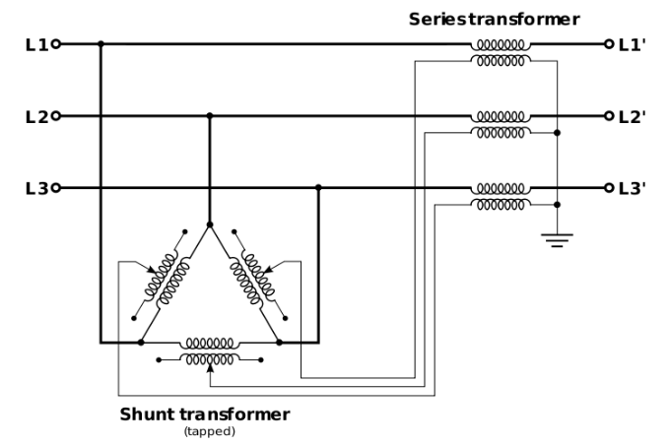
Phase Shifting Transformers
Phase shifting transformers are used to control the phase angle across the transformer
  Also called phase angle regulators (PARs) or quadrature booster transformers
Since power flow through the transformer depends upon phase angle, this allows the transformer to regulate the power flow
through the transformer
Phase shifters can be used to
prevent inadvertent "loop
flow" and to prevent line overloads.
Image Source: en.wikipedia.org/wiki/Quadrature_booster#/media/File:Qb-3ph.svg

Slide 35
Phase Shifter Example 3.13

Slide 36
Autotransformers
Autotransformers are transformers in which the primary and secondary windings are coupled magnetically and electrically.
This results in lower cost, and smaller size and weight.
The key disadvantage is loss of electrical isolation between the voltage levels. Hence auto-transformers are not used when a is large. For example in stepping down 7160/240 V we do not ever want 7160 on the low side!

